Slide 1
Pediatric Dosages
MAT 119

Slide 2
http://www.youtube.com/results?search_query=josie+king+story+video&oq=josie+king+&gs_l=youtube.3.0.0l5.3242.5107.0.7780.11.9.0.2.2.0.89.734.9.9.0...0.0...1ac.bil00pYbLJ4

Slide 3
Determine if Dose is Safe (mg/kg/dose)
The nurse must determine if the ordered dose is within the recommended range.
Even though the physician has prescribed the medication to be given, it is the nurse’s responsibility to determine if the dose is safe to administer to the child.
This is done by accurately calculating the dosage range and comparing the ordered dosage (mg/kg/dose).

Slide 4
Therapeutic/Safe Range
minimum
maximum
Dose Range
Not
Safe
Not
Safe

Slide 5
Example
A child weighs 22 lb. The order is for acetaminophen 100 mg p.o. q 6 h.
The recommended dose range is 10 to 15 mg/kg/dose q 6 h.
Step 1 – convert weight: 22 lbs = 10 kg
Step 2 – 10 mg x 10 kg = 100 mg/dose
15 mg x 10 kg = 150 mg/dose
A dose less than 100 mg/dose is not therapeutic and considered unsafe
A dose more than 150 mg is considered too much, exceeds the therapeutic range and is unsafe

Slide 6
Calculating a Recommended Dose Range
Order: 100 mg of ibuprofen p.o. q 6h for a child who weights 36 lbs.
Ibuprofen is available as 100 mg/5mL.
The recommended dose range is 5-10 mg/kg/dose q 6 h.
How many milliliters would you administer if the dose is safe?

Slide 7
Solution for 100 mg Ibuprofen Supply: 100 mg/5mL.
Step 1 – 36 lb = 16.4 kg
Step 2 – 16.4 kg x 5 mg = 82 mg/dose
16.4 kg x 10 mg = 164 mg/dose
The dose range is 82 mg – 164 mg/dose
Step 3 - The dose is safe
Step 4 - Administer 5 mL (1 t)

Slide 8
Calculate the 24-hour Dose Range
Most drugs are calculated based on the recommended 24-hour dose, then divided into single doses to be given every 12, 8, 6, or 4 hours or as recommended by the drug manufacturer.
Antibiotics are given this way.
The physician must determine the dosage to be given to the infant or child.
The nurse who administers the medication must determine if the dose is in a safe dose range.

Slide 9
Calculate the Individual Dose (mg/kg/24 h divided)
The physician determines how often the antibiotic will be administered as a single or individual dose.
First, determine the 24-hour dosage range.
Than, divide the 24-hour dosage into single doses (the number of times per day the medications is to be given)
As long as the dose does not exceed the maximum dose, or does not fall below the minimum dose, it can be given safely.

Slide 10
Example
An infant is admitted to the hospital and weighs 8 lb. Ampicillin 250 mg IV q 6h is prescribed.
The manufacturer recommends 200-400 mg/kg/24 h q 4-6 h.
Calculate the 24 hour dosage range (minimum & maximum); calculate the single dose range
Is the order dose safe?

Slide 11
Solution: Ampicillin 250 mg IV q 6h
Step 1 – 8 lbs = 3.6 kg
Step 2 – Recommended dose range:
3.6 kg x 200 mg/kg/24h = 720 mg/24h
3.6 kg x 400 mg/kg/24h = 1440 mg/24h
Step 3 – Single dose range
720 ÷ 4 =180 mg/dose; 1440 ÷ 4 = 360 mg/dose
The ordered dose is safe.

Slide 12
Example
The child weighs 35 lbs and is prescribed Amoxicillin 250 mg p.o. q 12h.
The manufacturer recommends 25-50 mg/kg/24 h in 2 or 3 divided doses.
Calculate the recommended 24 h dose range; calculate the single dose range.
Is the order safe?

Slide 13
Solution Amoxicillin 250 mg p.o. q 12h
Step 1 – 35 lb = 15.9 kg
Step 2 – Recommended dose range
15.9 kg x 25 mg/kg/24 h = 397.5 mg/24 h
15.9 kg x 50 mg/kg/24 h = 795 mg/24 h
Step 2 – Single dose range
397.5 ÷ 2 =198.8 mg; 795 ÷ 2 = 397.5 mg
The order is safe

Slide 14
Example
A 4-year-old child is receiving vancomycin 220 mg q6 h IV.
Her weight is 48 lbs.
The recommended dosage is 40-60 mg/kg/24h q 6h.
Is this a safe dose?

Slide 15
Solution
48 lbs = 21.8 kg
Ordered: Vancomycin 220 mg q 6 hr
Recommended: 40-60 mg/kg/24 h q 6 h
21.8 kg x 40 mg/24h = 872 mg/24h ÷ 4 = 218 mg/dose
21.8 kg x 60 mg/24h = 1308 mg/24h ÷ 4 = 327 mg/dose
Within the recommended dose range – safe dose

Slide 16
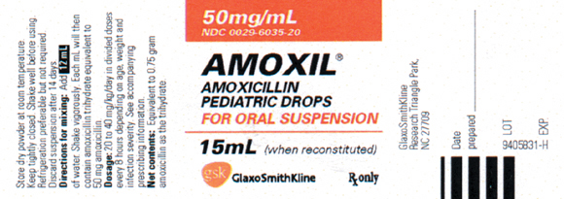
Example
The label recommends 20 mg – 40 mg/kg/day divided every 8 hours.
Calculate the dose range for a child weighing 10 kg.

Slide 17
Calculate the minimum and maximum single dose
Minimum total daily dosage:
20 mg/kg/day × 10 kg = 200 mg/day
Minimum dosage for each single dose:
200 mg ÷ 3 doses = 66.7 mg/dose
Maximum total daily dosage:
40 mg/kg/day × 10 kg = 400 mg/day
Maximum dosage for each single dose:
400 mg ÷ 3 doses = 133.3 mg/dose
The single dosage range is 66.7 to 133.3 mg/dose

Slide 18
Calculating the ordered dose to determine if safe
Order: Gentamycin 6 mg/kg/day in three divided doses IM for an 18-month-old who weighs 24 lb.
Manufacturer’s recommended dosage: 2-2.5 mg/kg q 8h.
Available: Gentamycin multi-dose vial 40 mg/mL
Is the order safe: _______________
If safe, administer ______________mL

Slide 19
Continued
Weight 24 lb = 10.9 kg
Ordered dose: 6 mg/kg/day = 6 x 10.9 = 65.4 mg/day ÷ 3 = 21.8 mg/dose
Manufacturer’s: 2-2.5 mg/kg q 8 h =
21.8 mg - 27.3 mg q 8h
Order is safe
Available 40 mg/mL; give 0.55 mL

Slide 20
Caution
Once an adolescent attains a weight of 50kg (110 lbs) or greater, the standard adult dosage is frequently prescribed.
Verify that the order for a child’s dosage does not exceed the maximum.

Slide 21
Calculation of Daily Volume for Maintenance Fluids
Chapter 16

Slide 22
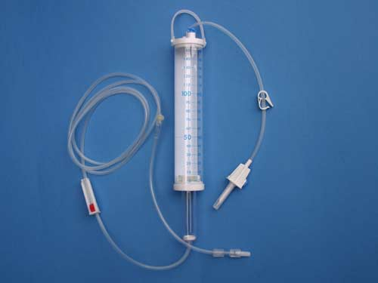
Fluid Control
Crucial in the pediatric population
Units often have policies that children are on a volume controlled device, using a buretrol to regulate volume.

Slide 23
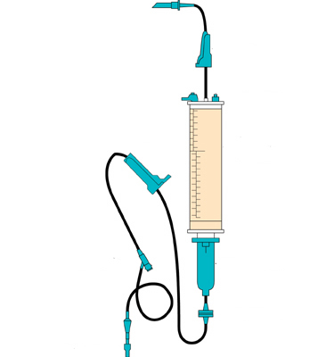
Volume Control Set
Clamp
Injection port
Clamp
Drug and fluid administration chamber
Injection port
Drip chamber
Check valve
Capped needle

Slide 24
Total Daily IV Fluid for Children
Use this formula to calculate the daily rate of pediatric maintenance IV fluids: (p. 503)
100 mL per kg per day for the first 10 kg of body weight
50 mL per kg per day for the next 10 kg of body weight
20 mL per kg per day for each kg above 20 kg of body weight
Hourly maintenance fluid requirements: Divide daily volume by 24 (hours/day) – round to whole number

Slide 25
Practice problem
Child weighs 16 pounds
Weight in kg = 7.27 = 7.3 kg
Using the formula provided how many mL of fluid would the child need in 24 hours?
100 mL x 7.3 kg = 730 mL/24 h or 30 mL/h

Slide 26
Fluid Calculation
64 pound child
Convert pounds to kilograms = 29.1 kg
Fluid calculations:
100 mL x 10 kg = 1000 mL
50 mL x 10 kg = 500 mL
20 mL x 9.1 kg = 182 mL
1682 mL / 24 hours or 70 mL / hour

Slide 27
Fluid Calculations
Because children are in the hospital for various illnesses they will often have increased fluid needs: dehydration, fever, vomiting, diarrhea, inability to take po fluids.
24 hour fluid calculations may be 1 ½ to 2 times maintenance.

Slide 28
Fluid Calculations
Child’s maintenance fluid needs are 713 mL / 24 hours.
Calculate 1 ½ time maintenance:
713 x 1 ½ = 1070 mL/24 hours or 45 mL/h

Slide 29
Fluid Calculation
Child’s maintenance fluid needs are 1681 mL / 24 hours.
Calculate1 ½ times maintenance:
1681 x 1 ½ = 2522 mL/24 h or 105 mL/h

Slide 30
Practice
Calculate the daily and hourly maintenance fluid requirements for a child weighing 5 kg.
100 mL x 5 kg = 500 mL / day
500 mL ÷ 24 hours = 20.8 = 21 mL / hr

Slide 31
Practice
Calculate the daily and hourly maintenance fluid requirements for a child weighing 15 kg.
1000 mL + (50 mL x 5 kg) = 1000 + 250 = 1250 mL/day
1250 mL ÷ 24 = 52 mL / hr

